Slide 1

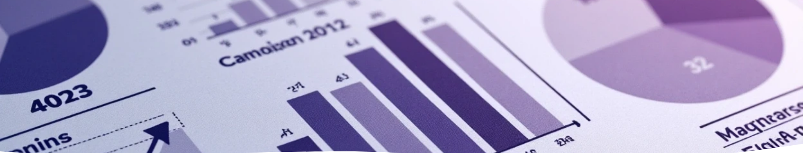

Marketing Analysis Performance Report
Author: ALi Abd EL Hamed

Slide 2

Questions
Which type of campaign gives the best ROI?
Which campaign Name gives the best ROI?
Which region has the highest revenue ?
does more spending actually lead to more returns?

Slide 3

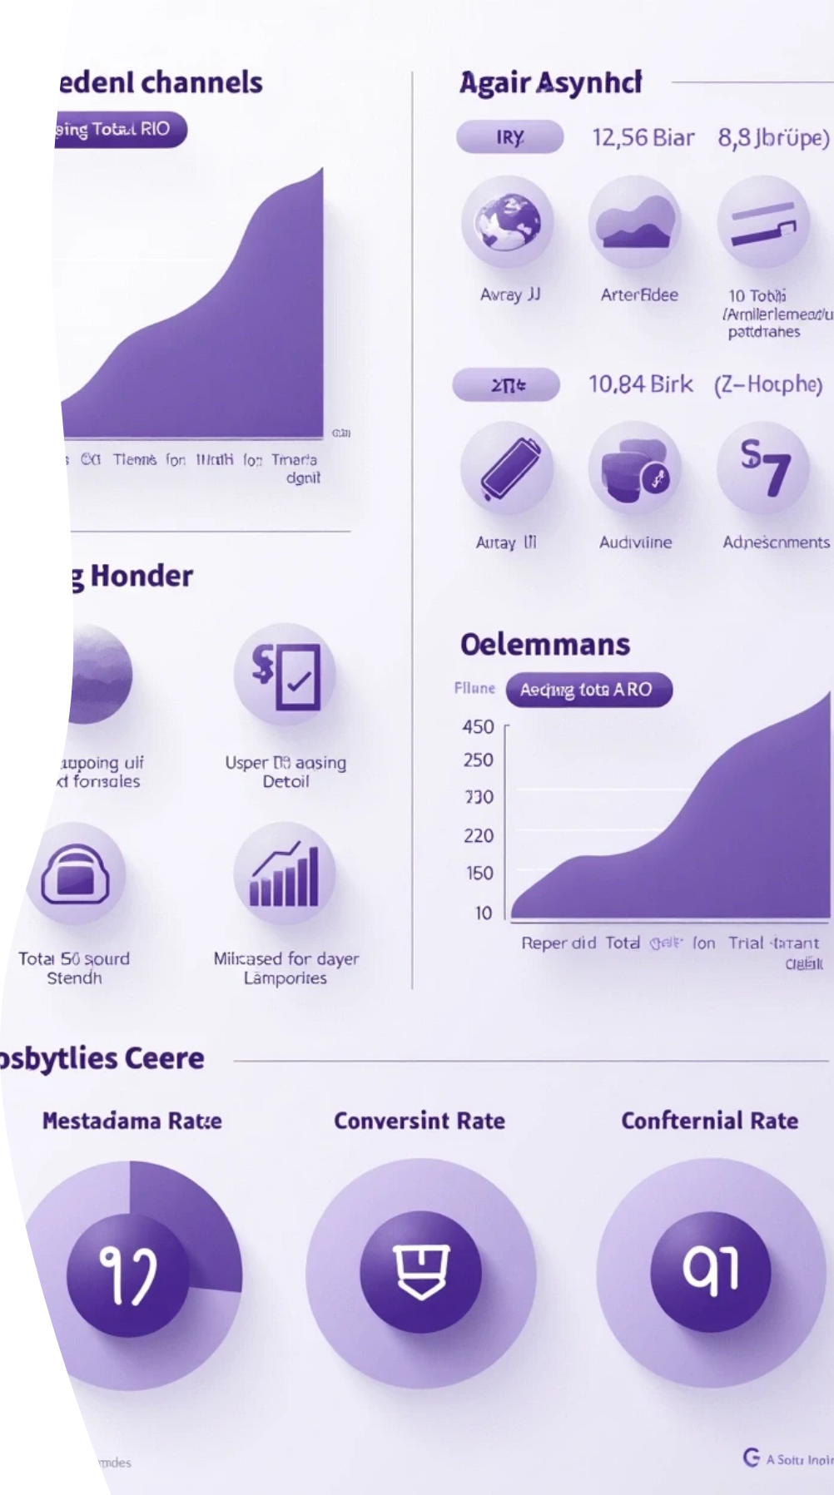

Overview
1
Financial Metrics
• Total Spend: $25.69M
• Total Revenue: $42.54M
• Average ROI: 0.68
• Conversion Rate: 10.18%
2
Top-performing Channels
• Influencer Marketing → ROI: 137.5 ✅
• Search Engine Ads → ROI: 87.8
• Social Media Ads → ROI: 88.0
3
Traditional Media Performance
• Meanwhile, traditional media like TV ads delivered significantly lower returns (ROI: %50.6).

Slide 4
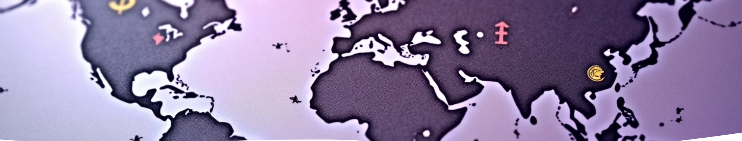
Performance by Region
Africa and Asia showed strong revenue relative to spend highlighting great potential for expansion.

Slide 5

Strategic Recommendations
1
Double down on high-ROI digital strategies
2
Rethink investment in traditional media
3
Explore untapped regional opportunities

Slide 6

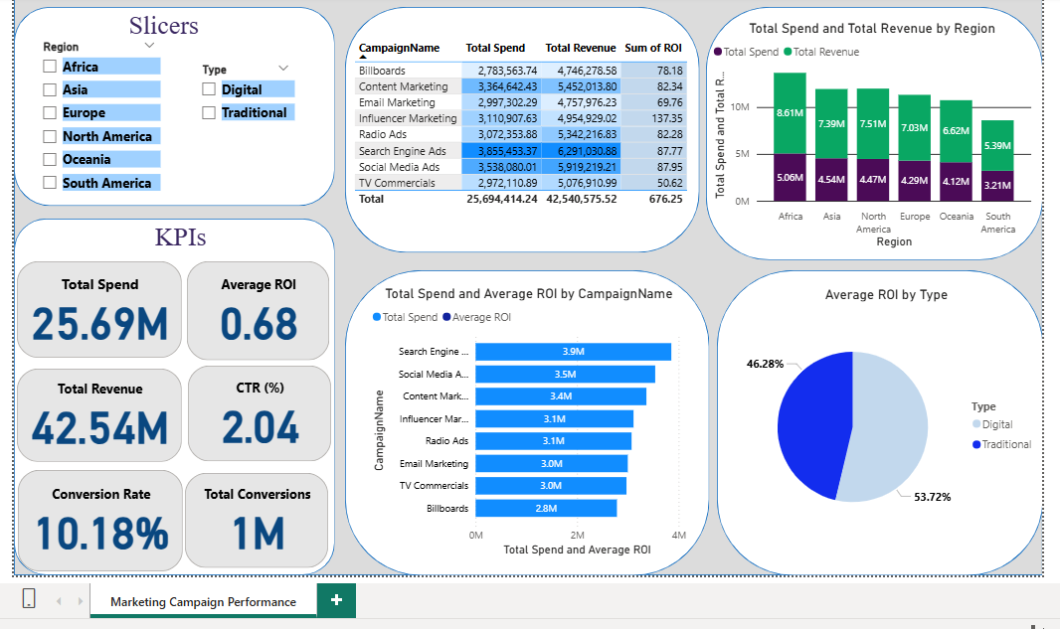

Slide 7
Thank You

